Slide 1
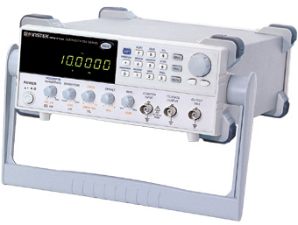
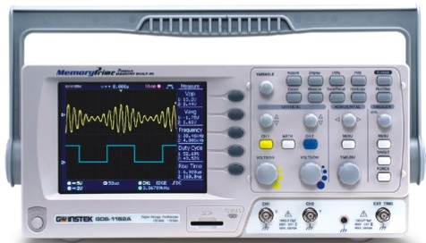
Introduction
Frequency response is the steady-state response of a system to a sinusoidal input.
In frequency-response methods, the frequency of the input signal is varied over a certain range and the resulting response is studied.
System

Slide 2
The Concept of Frequency Response
In the steady state, sinusoidal inputs to a linear system generate sinusoidal responses of the same frequency.
Even though these responses are of the same frequency as the input, they differ in amplitude and phase angle from the input.
These differences are functions of frequency.

Slide 3
The Concept of Frequency Response
Sinusoids can be represented as complex numbers called phasors.
The magnitude of the complex number is the amplitude of the sinusoid, and the angle of the complex number is the phase angle of the sinusoid.
Thus can be represented as
where the frequency, ω, is implicit.

Slide 4
The Concept of Frequency Response
A system causes both the amplitude and phase angle of the input to be changed.
Therefore, the system itself can be represented by a complex number.
Thus, the product of the input phasor and the system function yields the phasor representation of the output.

Slide 5
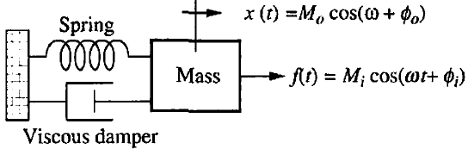
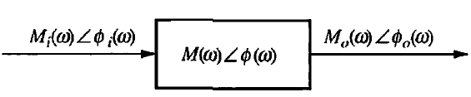
The Concept of Frequency Response
Consider the mechanical system.
If the input force, f(t), is sinusoidal, the steady-state output response, x(t), of the system is also sinusoidal and at the same frequency as the input.

Slide 6
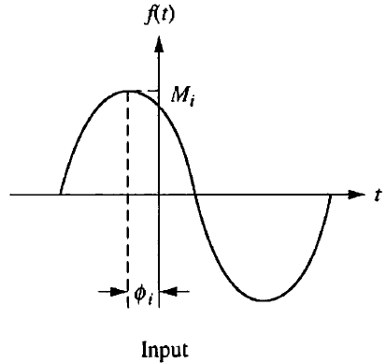
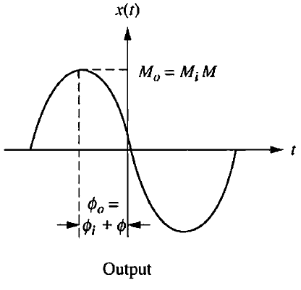
The Concept of Frequency Response
Assume that the system is represented by the complex number
The output is found by multiplying the complex number representation of the input by the complex number representation of the system.

Slide 7
The Concept of Frequency Response
Thus, the steady-state output sinusoid is
M_{o}(ω) is the magnitude response and Φ(ω) is the phase response. The combination of the magnitude and phase frequency responses is called the frequency response.

Slide 8
Frequency Domain Plots
Bode Plot
Nyquist Plot
Nichol’s Chart

Slide 9
Bode Plot
A Bode diagram consists of two graphs:
One is a plot of the logarithm of the magnitude of a sinusoidal transfer function.
The other is a plot of the phase angle.
Both are plotted against the frequency on a logarithmic scale.

Slide 10
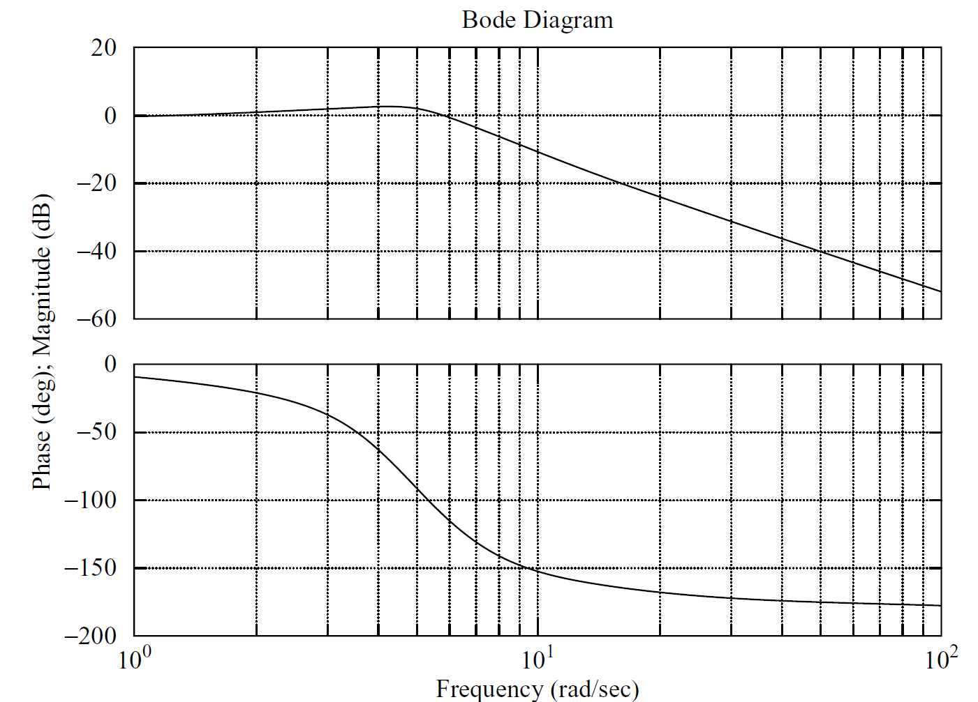

Slide 11

Decade

Slide 12

Basic Factors of a Transfer Function
The basic factors that very frequently occur in an arbitrary transfer function are
Gain K
Integral and Derivative Factors (jω)^{±1}
First Order Factors (jωT+1)^{±1}
Quadratic Factors

Slide 13
Basic Factors of a Transfer Function
Gain K
The log-magnitude curve for a constant gain K is a horizontal straight line at the magnitude of 20 log(K) decibels.
The phase angle of the gain K is zero.
The effect of varying the gain K in the transfer function is that it raises or lowers the log-magnitude curve of the transfer function by the corresponding constant amount, but it has no effect on the phase curve.

Slide 14
15
Magnitude (decibels)
5
-5
-15
0.1
1
10
100
10³
10⁴
10⁵
10⁶
10⁷
10⁸
10⁹
Frequency (rad/sec)

Slide 15
90º
30º
Phase (degrees)
0º
-30⁰
-90º
0.1
1
10
100
10³
10⁴
10⁵
10⁶
10⁷
10⁸
10⁹
Frequency (rad/sec)

Slide 16
Basic Factors of a Transfer Function
Integral and Derivative Factors (jω)^{±1}
Derivative Factor
Magnitude
ω | 0.1 | 0.2 | 0.4 | 0.5 | 0.7 | 0.8 | 0.9 | 1
db | -20 | -14 | -8 | -6 | -3 | -2 | -1 | 0
Slope=6b/octave
Slope=20db/decade
Phase

Slide 17
30
Magnitude (decibels)
10
0
-10
-20
-30
0.1
1
10
100
10³
10⁴
10⁵
10⁶
10⁷
10⁸
10⁹
Frequency (rad/sec)

Slide 18
180º
90⁰
60º
Phase (degrees)
0º
-60⁰
-180º
0.1
1
10
100
10³
10⁴
10⁵
10⁶
10⁷
10⁸
10⁹
Frequency (rad/sec)

Slide 19
Basic Factors of a Transfer Function
Integral and Derivative Factors (jω)^{±1}
When expressed in decibels, the reciprocal of a number differs from its value only in sign; that is, for the number N,
Therefore, for Integral Factor the slope of the magnitude line would be same but with opposite sign (i.e -6db/octave or -20db/decade).
Magnitude
Phase

Slide 20
30
20
Magnitude (decibels)
10
0
-10
-30
0.1
1
10
100
10³
10⁴
10⁵
10⁶
10⁷
10⁸
10⁹
Frequency (rad/sec)

Slide 21
180º
60º
Phase (degrees)
0º
-60⁰
-90⁰
-180º
0.1
1
10
100
10³
10⁴
10⁵
10⁶
10⁷
10⁸
10⁹
Frequency (rad/sec)

Slide 22
Basic Factors of a Transfer Function
First Order Factors (jωT+1)
For Low frequencies ω<<1/T
For high frequencies ω>>1/T

Slide 23
Basic Factors of a Transfer Function
First Order Factors (jωT+1)

Slide 24
30
20
6 db/octave
Magnitude (decibels)
10
20 db/decade
0
ω=3
-10
-30
0.1
1
10
100
10³
10⁴
10⁵
10⁶
10⁷
10⁸
10⁹
Frequency (rad/sec)

Slide 25
90º
45º
30º
Phase (degrees)
0º
-30⁰
-90º
0.1
1
10
100
10³
10⁴
10⁵
10⁶
10⁷
10⁸
10⁹
Frequency (rad/sec)

Slide 26
Basic Factors of a Transfer Function
First Order Factors (jωT+1)⁻¹
For Low frequencies ω<<1/T
For high frequencies ω>>1/T

Slide 27
Basic Factors of a Transfer Function
First Order Factors (jωT+1)⁻¹

Slide 28
30
Magnitude (decibels)
10
0
ω=3
-10
-6 db/octave
-20 db/decade
-20
-30
0.1
1
10
100
10³
10⁴
10⁵
10⁶
10⁷
10⁸
10⁹
Frequency (rad/sec)

Slide 29
90º
30º
Phase (degrees)
0º
-30⁰
-45º
-90º
0.1
1
10
100
10³
10⁴
10⁵
10⁶
10⁷
10⁸
10⁹
Frequency (rad/sec)

Slide 30
Example#1
Draw the Bode Plot of following Transfer function.
Solution:
The transfer function contains
Gain Factor (K=2)
Derivative Factor (s)
1st Order Factor in denominator (0.1s+1)⁻¹

Slide 31
Example#1
Gain Factor (K=2)
Derivative Factor (s)
1st Order Factor in denominator (0.1s+1)

Slide 32
30
20 db/decade
Magnitude (decibels)
10
K=2
0
-10
-20 db/decade
-20
-30
0.1
1
10
100
10³
10⁴
10⁵
10⁶
10⁷
10⁸
10⁹
Frequency (rad/sec)

Slide 33
30
-20 db/decade+20db/decade
Magnitude (decibels)
10
20 db/decade
0
-10
-20
-30
0.1
1
10
100
10³
10⁴
10⁵
10⁶
10⁷
10⁸
10⁹
Frequency (rad/sec)

Slide 34
Example#1
ω | 0.1 | 1 | 5 | 10 | 20 | 40 | 70 | 100 | 1000 | ∞
Φ(ω) | 89.4 | 84.2 | 63.4 | 45 | 26.5 | 14 | 8 | 5.7 | 0.5 | 0

Slide 35
ω | 0.1 | 1 | 5 | 10 | 20 | 40 | 70 | 100 | 1000 | ∞
Φ(ω) | 89.4 | 84.2 | 63.4 | 45 | 26.5 | 14 | 8 | 5.7 | 0.5 | 0
90º
30º
Phase (degrees)
0º
-30⁰
-45º
-90º
0.1
1
10
100
10³
10⁴
10⁵
10⁶
10⁷
10⁸
10⁹
Frequency (rad/sec)

Slide 37
Example#2
Solution:

Slide 38
Basic Factors of a Transfer Function
Quadratic Factors
For Low frequencies ω<< ω_{n}
For high frequencies ω>> ω_{n}

Slide 39
Minimum-Phase & Non-minimum Phase Systems

Slide 40
Minimum-Phase & Non-minimum Phase Systems

Slide 41
Minimum-Phase & Non-minimum Phase Systems

Slide 42
Minimum-Phase & Non-minimum Phase Systems

Slide 43
Minimum-Phase & Non-minimum Phase Systems

Slide 44
Minimum-Phase & Non-minimum Phase Systems
Transfer functions having neither poles nor zeros in the right-half s plane are minimum-phase transfer functions.
Whereas, those having poles and/or zeros in the right-half s plane are non-minimum-phase transfer functions.

Slide 45


Relative Stability
Phase crossover frequency (ω_{p}) is the frequency at which the phase angle of the open-loop transfer function equals –180°.
The gain crossover frequency (ω_{g}) is the frequency at which the magnitude of the open loop transfer function, is unity.
The gain margin (K_{g}) is the reciprocal of the magnitude of G(jω) at the phase cross over frequency.
The phase margin (γ) is that amount of additional phase lag at the gain crossover frequency required to bring the system to the verge of instability.

Slide 46
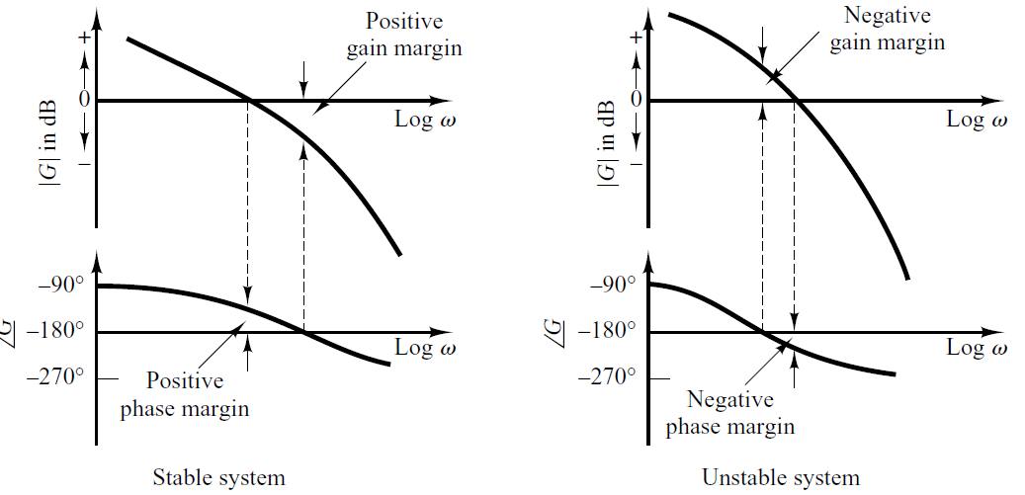
Relative Stability

Slide 47
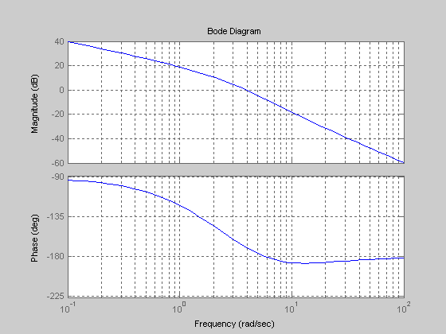
Gain cross-over point
Phase cross-over point
ω_{g}
ω_{p}

Slide 48

Unstable Stable
Stable
Gain Margin
Stable
Phase Margin
Unstable Stable
ω_{g}
ω_{p}

Slide 49
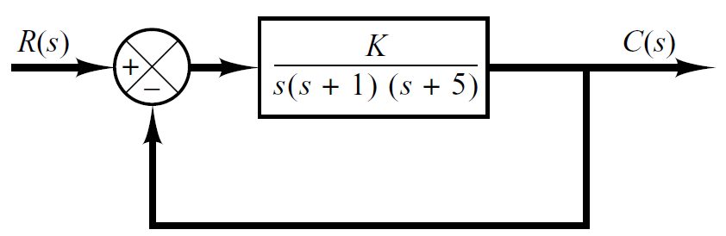
Example#3
Obtain the phase and gain margins of the system shown in following figure for the two cases where K=10 and K=100.

Slide 50
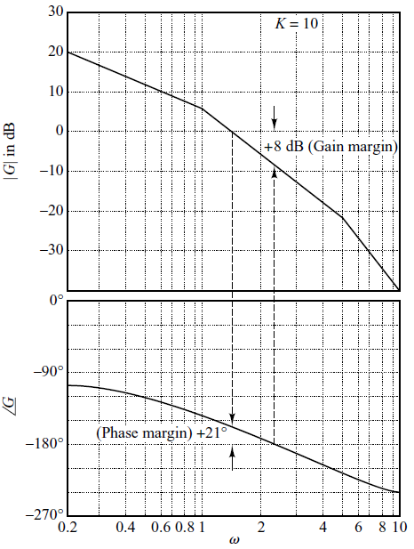
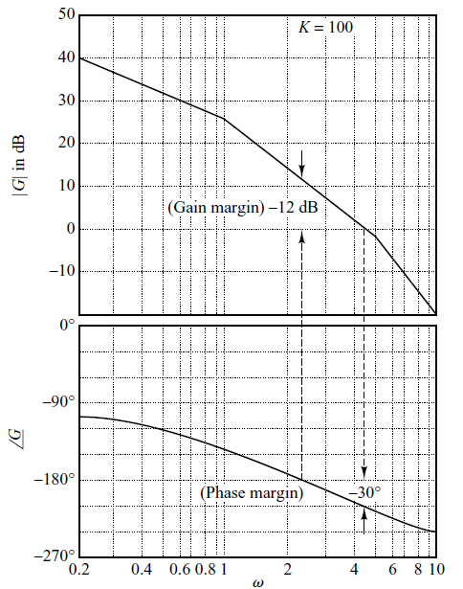

Slide 51
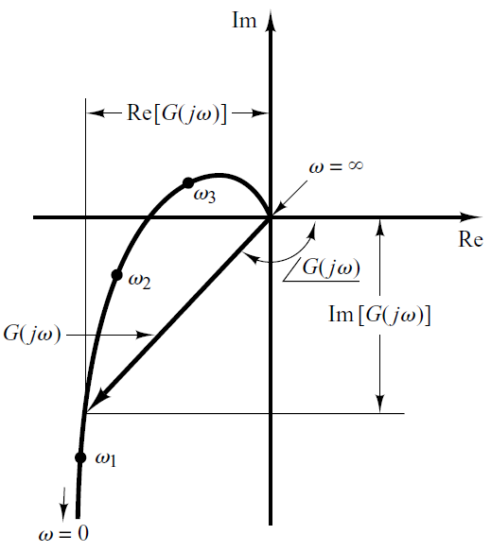

Nyquist Plot (Polar Plot)
The polar plot of a sinusoidal transfer function G(jω) is a plot of the magnitude of G(jω) versus the phase angle of G(jω) on polar coordinates as ω is varied from zero to infinity.
Thus, the polar plot is the locus of vectors as ω is varied from zero to infinity.

Slide 52
Nyquist Plot (Polar Plot)
Each point on the polar plot of G(jω) represents the terminal point of a vector at a particular value of ω.
The projections of G(jω) on the real and imaginary axes are its real and imaginary components.

Slide 53
Nyquist Plot (Polar Plot)
An advantage in using a polar plot is that it depicts the frequency response characteristics of a system over the entire frequency range in a single plot.
One disadvantage is that the plot does not clearly indicate the contributions of each individual factor of the open-loop transfer function.

Slide 54
Nyquist Plot of Integral and Derivative Factors
The polar plot of G(jω)=1/jω is the negative imaginary axis, since
Im
Re
ω=∞
-90º
ω=0

Slide 55
Nyquist Plot of Integral and Derivative Factors
The polar plot of G(jω)=jω is the positive imaginary axis, since
Im
ω=∞
90º
ω=0
Re

Slide 56
Nyquist Plot of First Order Factors
The polar plot of first order factor in numerator is
ω | Re | Im
0 | 1 | 0
1 | 1 | 1
2 | 1 | 2
∞ | 1 | ∞
Im
ω= ∞
2
ω=2
1
ω=1
ω=0
Re
1

Slide 57
Nyquist Plot of First Order Factors
The polar plot of first order factor in denominator is
ω | Re | Im
0 | 1 | 0
0.5 | 0.8 | 0.4
1 | 1/2 | -1/2
2 | 1/5 | -2/5
∞ | 0 | 0

Slide 58
Nyquist Plot of First Order Factors
The polar plot of first order factor in denominator is
ω | Re | Im
0 | 1 | 0
0.5 | 0.8 | -0.4
1 | 0.5 | -0.5
2 | 0.2 | -0.4
∞ | 0 | 0
Im
ω= ∞
0.2
0.5
0.8
1
Re
ω=0
-0.4
ω=2
-0.5
ω=0.5
ω=1

Slide 59
Nyquist Plot of First Order Factors
The polar plot of first order factor in denominator is
ω | Re | Im
0 | 1 | 0 | 1 | 0º
0.5 | 0.8 | -0.4 | 0.9 | -26º
1 | 0.5 | -0.5 | 0.7 | -45º
2 | 0.2 | -0.4 | 0.4 | -63º
∞ | 0 | 0 | 0 | -90
Im
ω= ∞
ω=0
Re
ω=2
ω=0.5
ω=1

Slide 60
Example#1
Draw the polar plot of following open loop transfer function.
Solution

Slide 61
Example#1
ω | Re | Im
0 | ∞ | ∞
0.1 | -1 | -10
0.5 | -0.8 | -1.6
1 | -0.5 | -0.5
2 | -0.2 | -0.1
3 | -0.1 | -0.03
∞ | 0 | 0

Slide 62
Example#1
ω | Re | Im
0 | ∞ | ∞
0.1 | -1 | -10
0.5 | -0.8 | -1.6
1 | -0.5 | -0.5
2 | -0.2 | -0.1
3 | -0.1 | -0.03
∞ | 0 | 0
Im
-1
ω=∞
Re
ω=2
ω=3
ω=1
ω=0.5
ω=0.1
-10
ω=0

Slide 63
Nyquist Stability Criterion
Im
The Nyquist stability criterion determines the stability of a closed-loop system from its open-loop frequency response and open-loop poles.
A minimum phase closed loop system will be stable if the Nyquist plot of open loop transfer function does not encircle (-1, j0) point.
(-1, j0)
Re

Slide 64
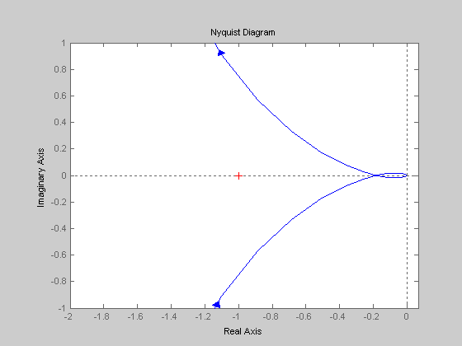
Gain Margin
Phase Margin
Gain cross-over point
Phase cross-over point

Slide 65
Nichol’s Chart (Log-magnitude vs Phase Plot)
Another approach to graphically portraying the frequency-response characteristics is to use the log-magnitude-versus-phase plot.
Which is a plot of the logarithmic magnitude in decibels versus the phase angle for a frequency range of interest.
In the manual approach the log-magnitude-versus-phase plot can easily be constructed by reading values of the log magnitude and phase angle from the Bode diagram.
Advantages of the log-magnitude-versus-phase plot are that the relative stability of the closed-loop system can be determined quickly and that compensation can be worked out easily.

Slide 66
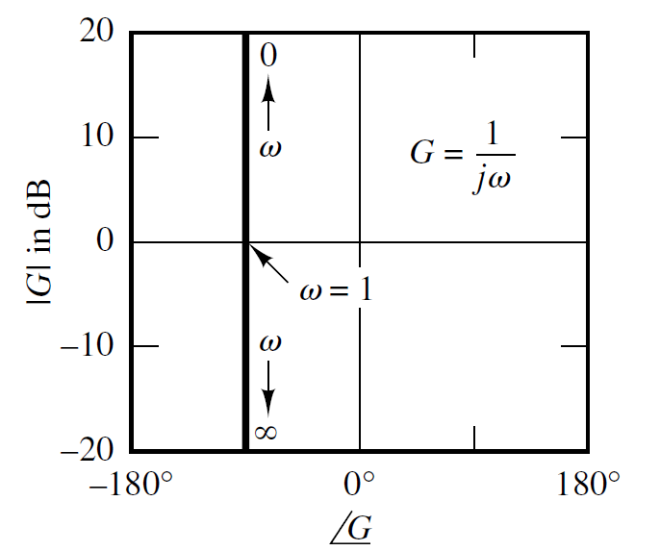
Nichol’s Chart of simple transfer functions
ω | db | φ
0 | ∞ | -90º
0.5 | 6 | -90º
1 | 0 | -90º
2 | -6 | -90º
∞ | -∞ | -90º

Slide 67
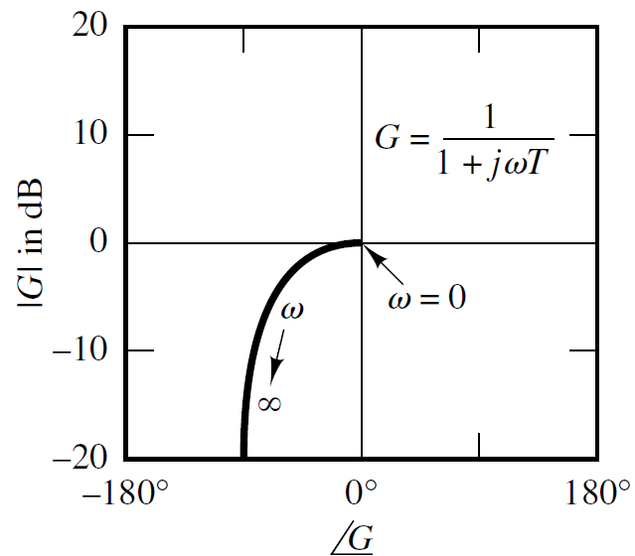
Nichol’s Chart of simple transfer functions

Slide 68
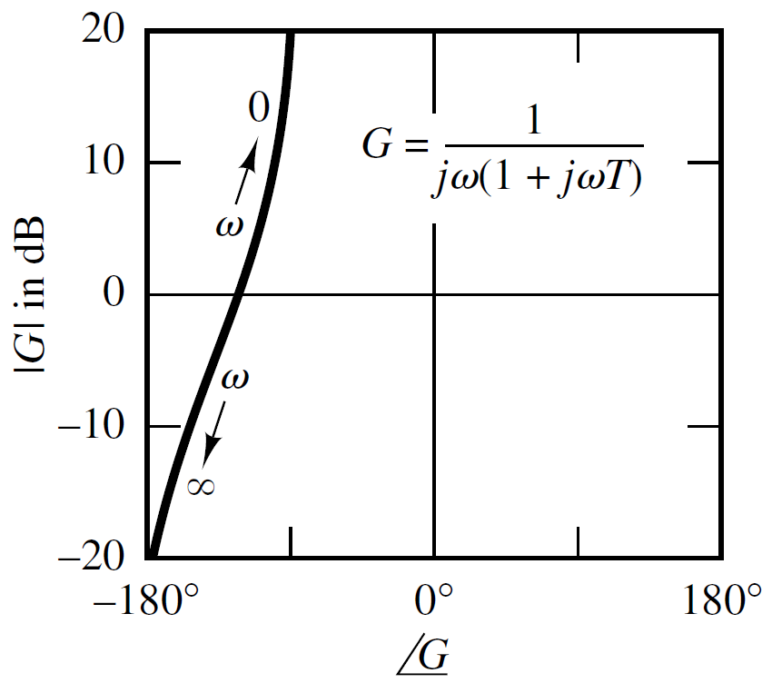
Nichol’s Chart of simple transfer functions

Slide 69
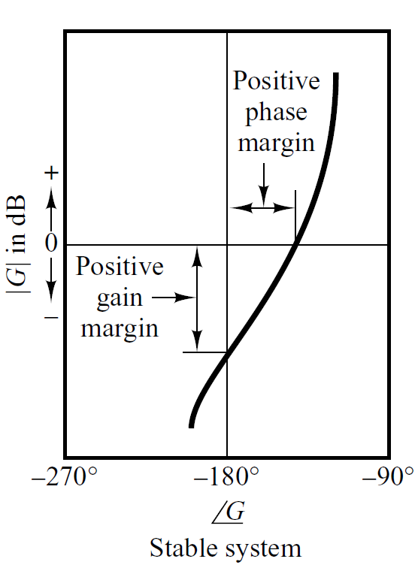
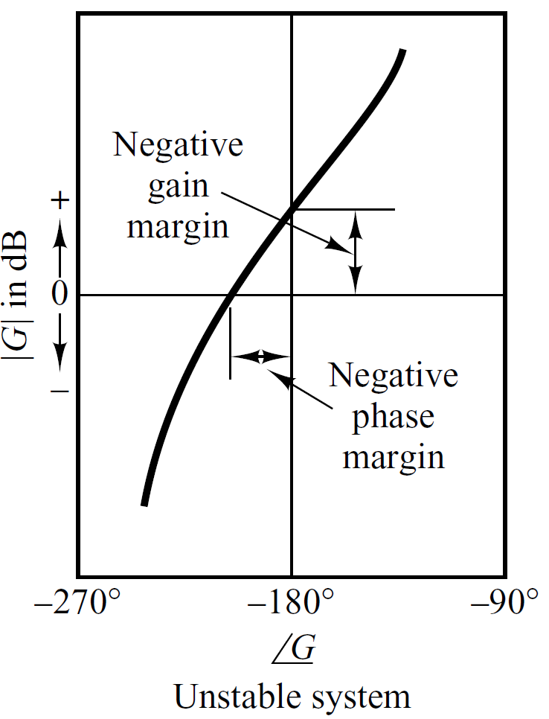
Relative Stability

Slide 70
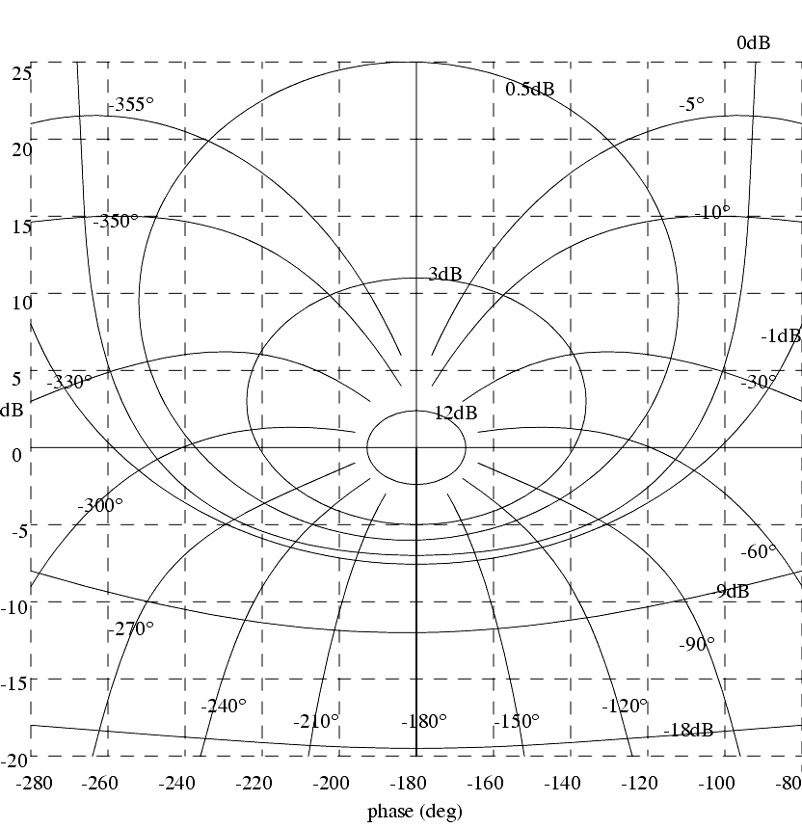

Slide 71
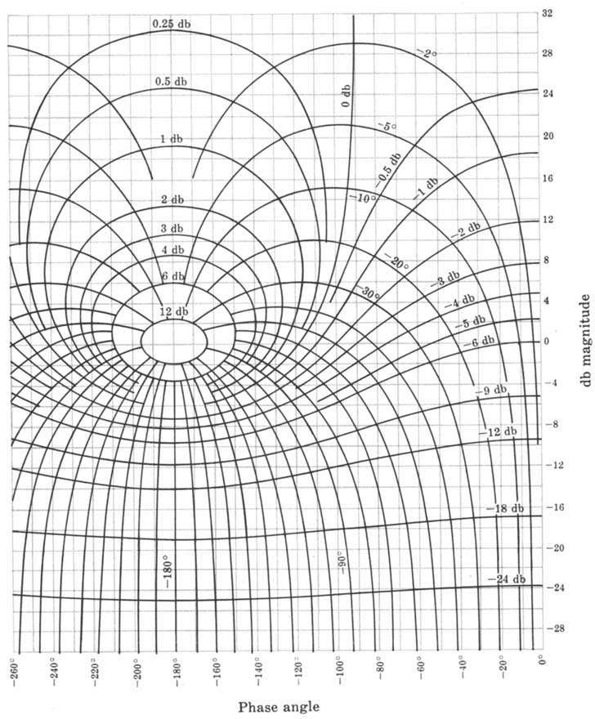

Slide 72
Example#1
Draw the Nichol’s Chart of following open loop transfer function and obtain the Gain Margin and Phase Margin.
Solution

Slide 73
Example#1

Slide 74
Example#1
ω
0.01 | 30 | -90º
0.1 | 10.3 | -97.5º
0.5 | -4.4 | -125º
1 | -14 | -153º
2 | -22 | -180º
10 | -26 | -189º

Slide 75
ω
0.01 | 30 | -90º
0.1 | 10.3 | -97.5º
0.5 | -4.4 | -125º
1 | -14 | -153º
2 | -22 | -180º
10 | -26 | -189º

Slide 76
Phase Margin=70⁰
Gain Margin=22 db
Gain Cross over point
Phase Cross over point

